Slide 1
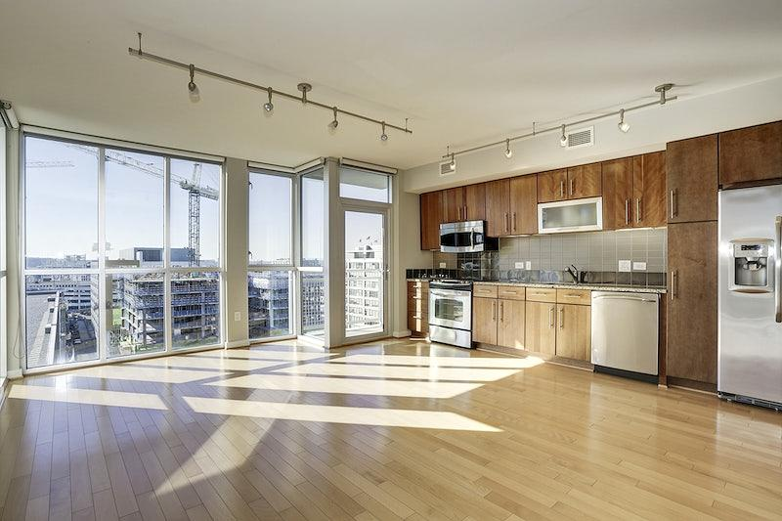

House Prices Prediction
Decoding rental prices in CT
Notes:
For project title

Slide 2

Table of Contents:
Meet our Team
Problem Statement
Solution
Project Pipeline
Technology Deployed
CT Rental Trend

Slide 3

Meet Our Team
Abhishek Kukreja
Vaishnavi Malapati Sai
Srijani Challagundla
Sai
Sai Deekshith Miyapuram
Omkar Avinash
Notes:
Project members

Slide 4

UNH attracts international students every year and finding an apartment in a new country becomes an arduous task
Rental amount comes with an added burden on a student's wallet therefore students can plan their expenses if they know the rental property prices in nearby counties
We are trying to decode the rental property prices on the CT basis of each county
Problem Statement
What are we trying to solve?
Problem Statement
UNH attracts international students every year finding an apartment in a new country becomes an arduous task
Rental amount comes with an added burden on a student's wallet therefore students can plan their expenses if they know the rental property prices in nearby counties
We are trying to decode the rental property prices on the CT basis of each county
A house price dataset is extracted from zillow using API, will be used to build a machine learning model that predicts house prices
Features such as number of bedrooms, rent, distance from university, location, etc will be used to create the model
Python numpy and pandas libraries will allow us to clean and prepare the data for modeling
A end-to-end web development will provide users home price predictions
How are we solving it?
Notes:
Problem Statement
We also aim to make the model robust by deploying it on a website and giving the end user options to control the apartment settings based on their need e.g. number of bedrooms, distance from the University, transportation availability etc.

Slide 5






Technology Deployed
How are we achieving it?
Python libraries such as pandas and numpy will be used for data processing
Python libraries such as matplotlib and seaborn will be used to visualize the data
Python libraries such as sklearn will be used to predict and build models
Java Script will be used to display the model over the web
Python flask will be used to deploy the model over the web
Notes:
Technology deployment

Slide 6
Project Pipeline
Data processing elements involved in the project
Data Extraction
Feature Engineering
Data Cleaning & Visualizarion
Model Building
Model Deployment
Downloading Zillow data
Transforming the data to better represent the underlying problem
Adding features to take care of time series problem
Performing EDA to carry out the data analysis
Checking null values, calculating rent for each location and apartment type
Building the model using linear regression in sklearn
Using Python flask server to serve https request
Website that allow users to enter attributes and retrieve the predicted rental price
Notes:
Data pipeline

Slide 7
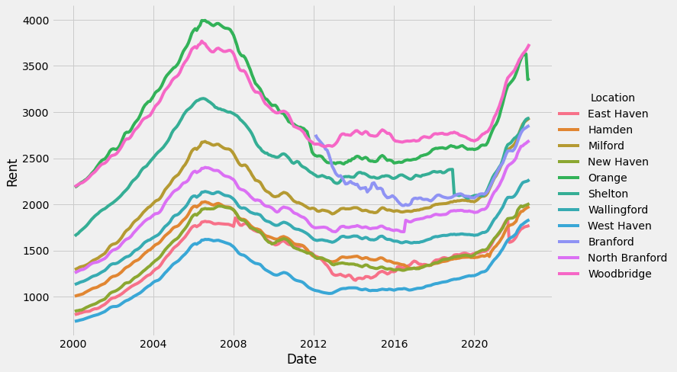
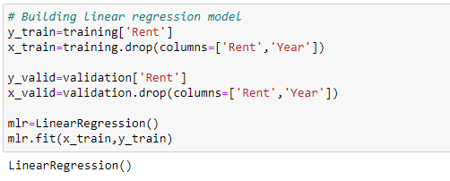
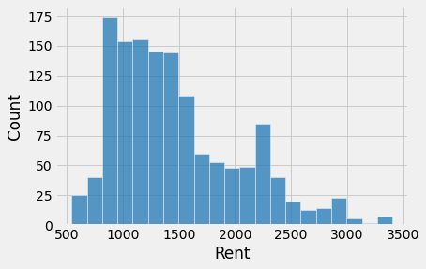
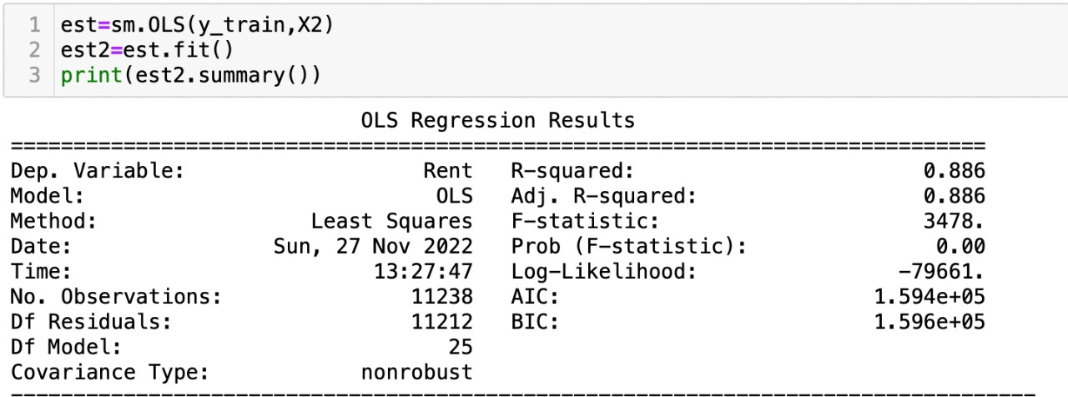
Visualization & Technical Details
How did we model it?

Slide 8
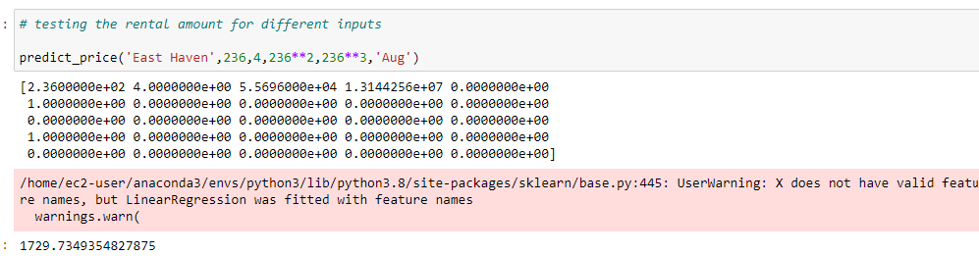
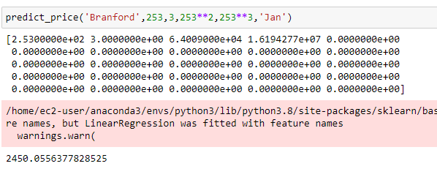
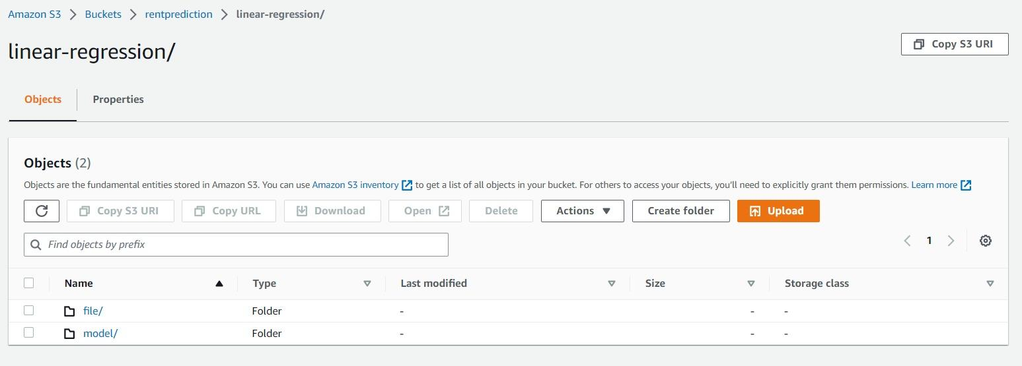
Storage & Model prediction

Slide 9
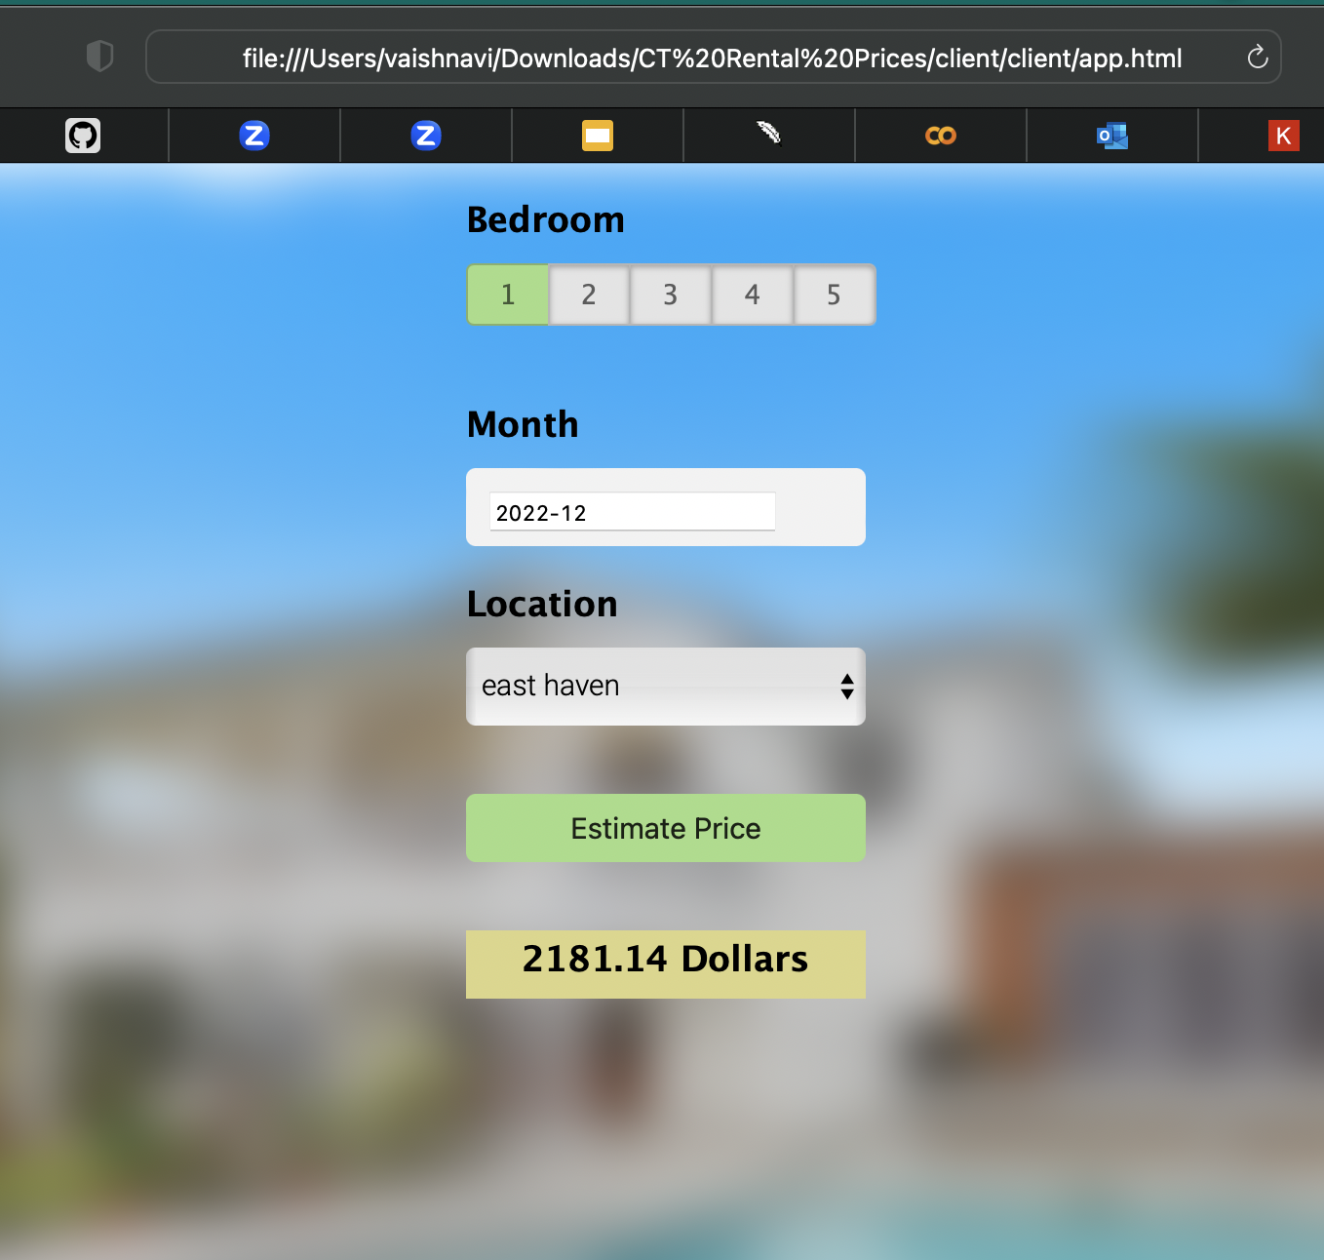
User Interface & Predict Prices
How does the UI look?
Front End: HTML, CSS, JS
Hosting Service: Python Flask server
Model Execution Environment: AWS SageMaker

Slide 10

Conclusion and Future Work
International students don’t know what are the expected rental costs in different cities around University of New Haven. So our model provides them with an easy way to figure this out.
They can get the predicted prices of the houses based on their requirement of no.of bedrooms and on location.
To improve the accuracy of this model we can add more data to train our model and to incorporate the inflation rate into our model when predicting rental rates. By training our model with these values we will be able to provide more accurate prices.
Future Work: With the support of University Officials, if we can include our website in mycharger portal, then it will be easy for the students to access and find the houses while registering for the courses.
Github Repository
https://github.com/UNH-FantasticFive

Slide 11

Thank You…

